Slide 1
ReactJS,
React-Router v4
Mark Shulhin
May 16, 2019
CONFIDENTIAL | © 2019 EPAM Systems, Inc.

Slide 2
What we will do today?
React, React-Router 😲
A lot of code 💻
Ask questions

Slide 3
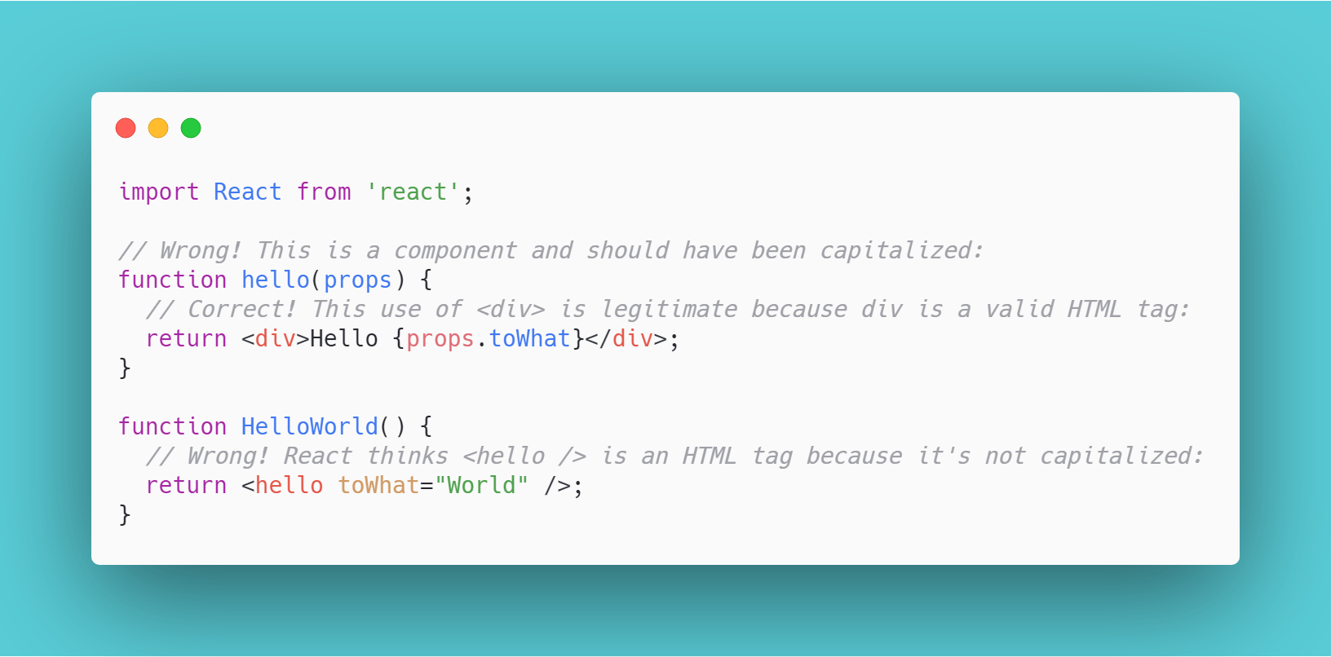
JSX in Depth

Slide 4
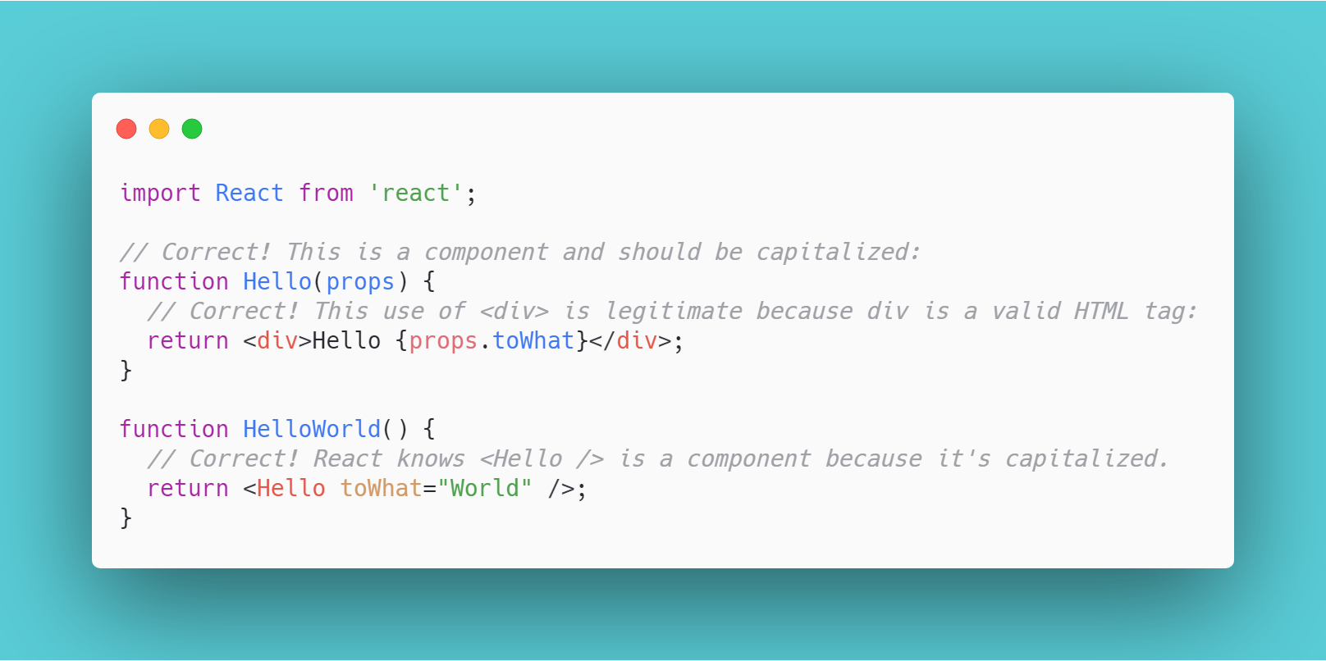
JSX in Depth(correct)

Slide 5
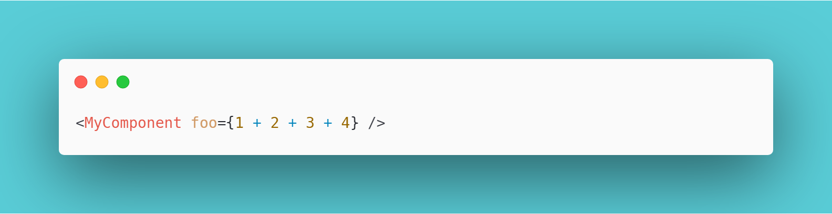
JavaScript Expressions as Props
You can pass any JavaScript expression as a prop, by surrounding it with {}. For example, in this JSX foo will evaluate to 10

Slide 6
Conditional Rendering
In React, you can create distinct components that encapsulate behavior you need. Then, you can render only some of them, depending on the state of your application.

Slide 7
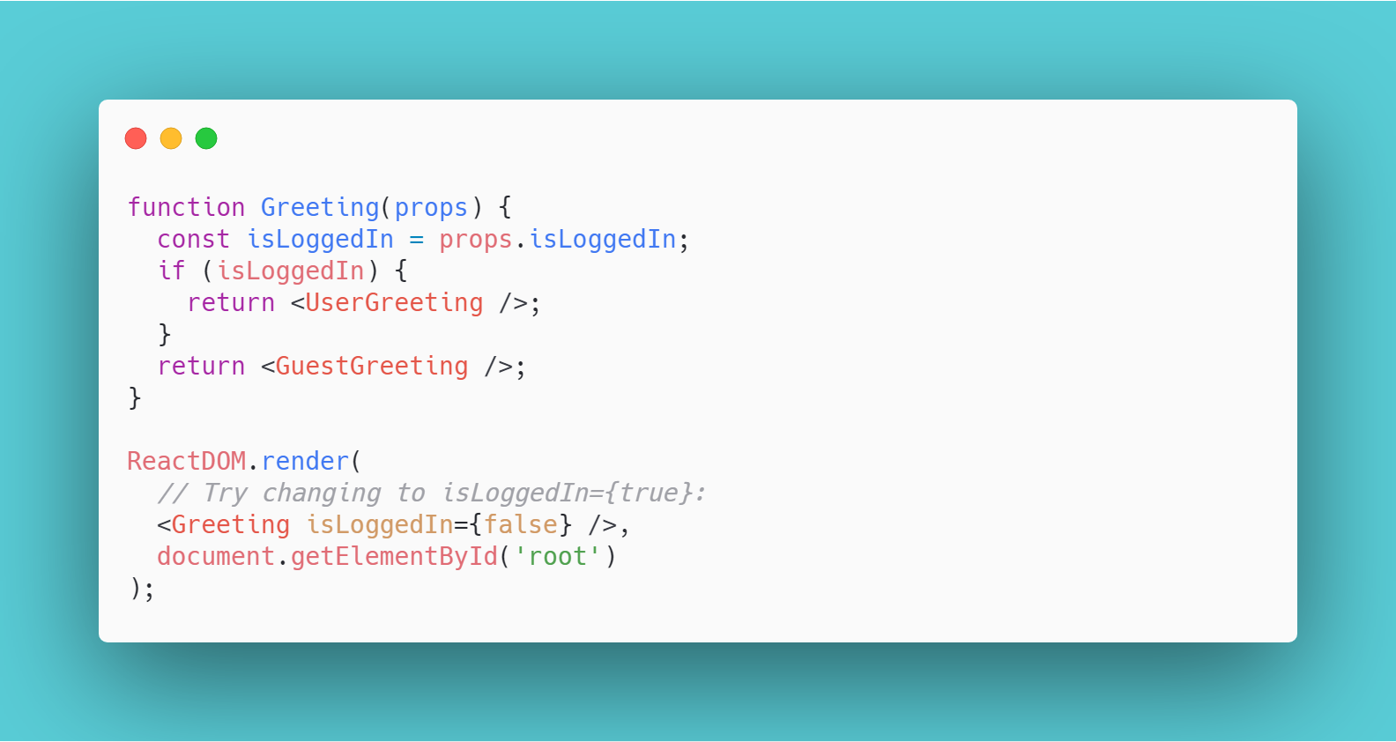
Conditional Rendering

Slide 8
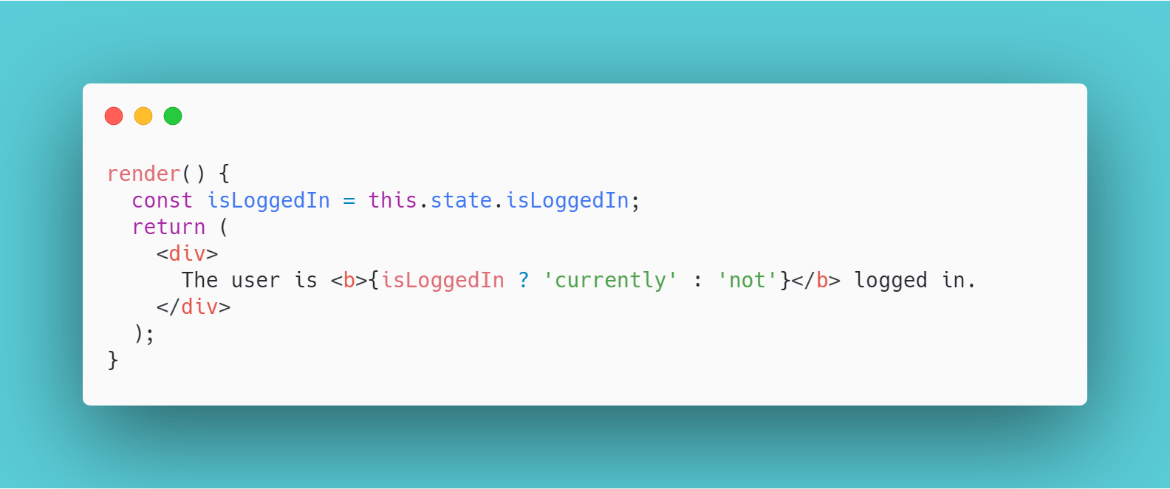
Inline If-Else with Conditional Operator

Slide 9

What is component?
Components let you split the UI into independent, reusable pieces, and think about each piece in isolation
XX

Slide 10
Ways of defining a React component?
Functional component
Extend React.Component
Extend React.PureComponent
XX

Slide 11
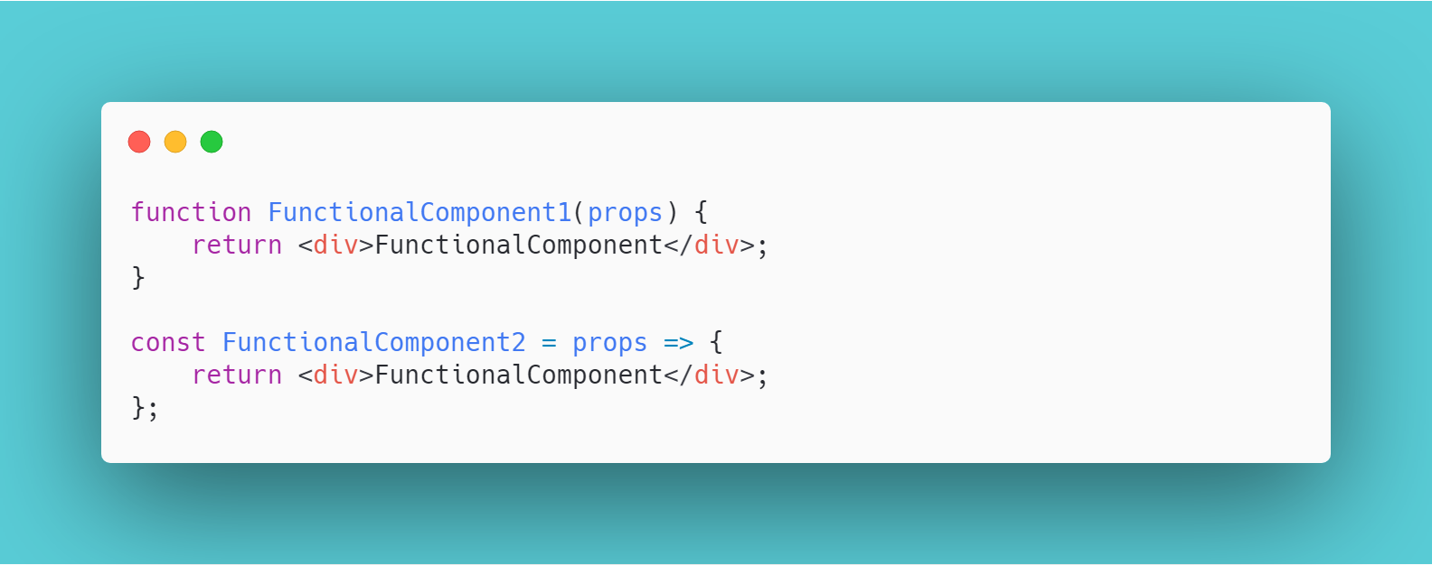
Functional
XX

Slide 12
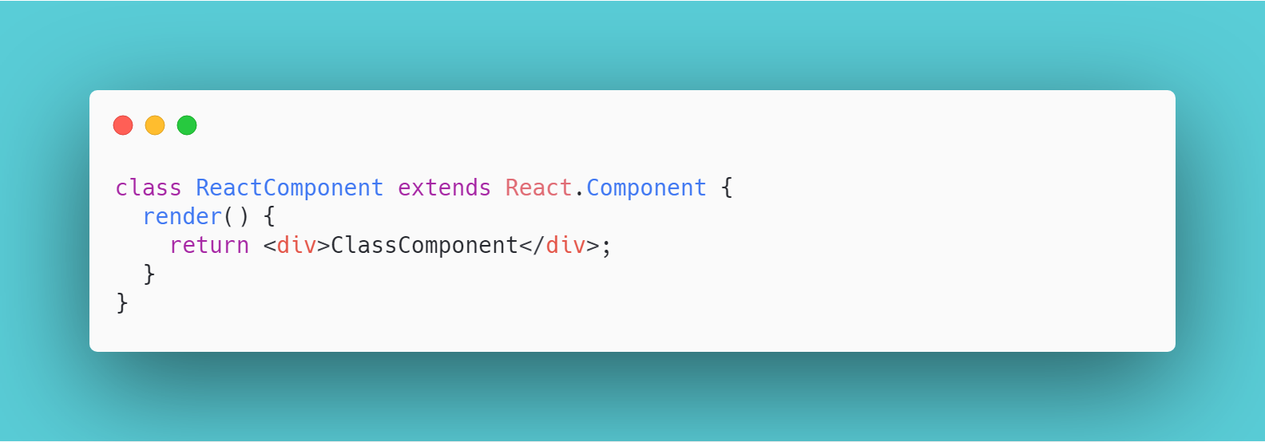
React.Component
XX

Slide 13
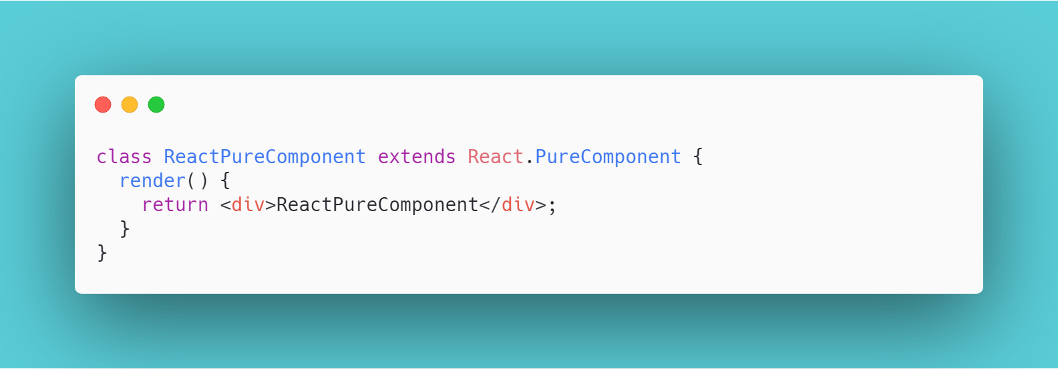
React.PureComponent
XX

Slide 14
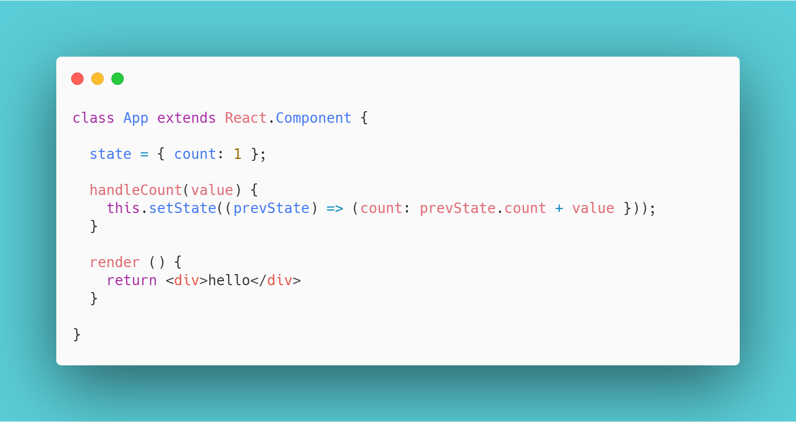
Stateful Components vs. Stateless Components
XX
Notes:
Stateful components are always class components. As previously mentioned, stateful components have a state that gets initialized in the constructor.
https://codepen.io/_danko/pen/AXdJLR

Slide 15
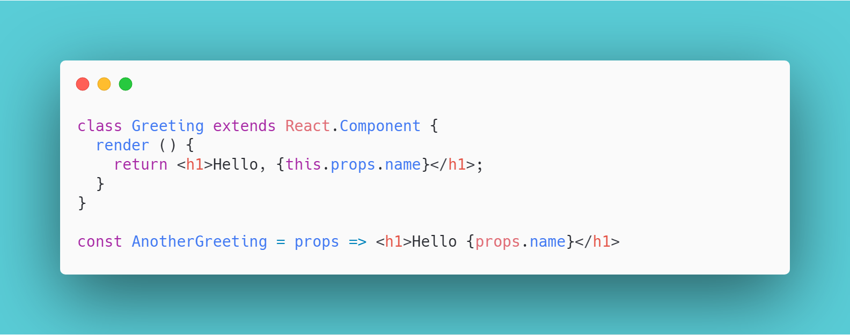
Stateful Components vs. Stateless Components
XX
Notes:
You can use either a function or a class for creating stateless components. But unless you need to use a lifecycle hook in your components, you should go for stateless functional components.

Slide 16
Handling events
React events are named using camelCase, rather than lowercase.
With JSX you pass a function as the event handler, rather than a string.
XX

Slide 17
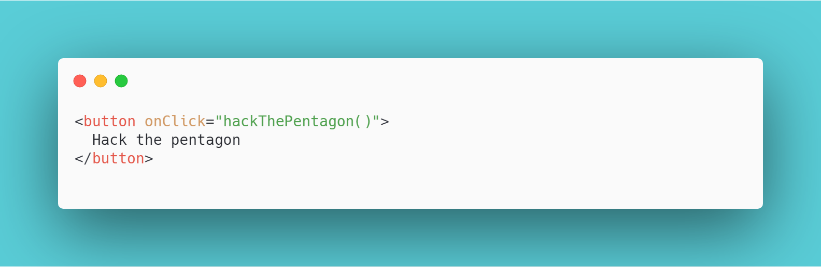
Handling event in plain HTML
XX

Slide 18
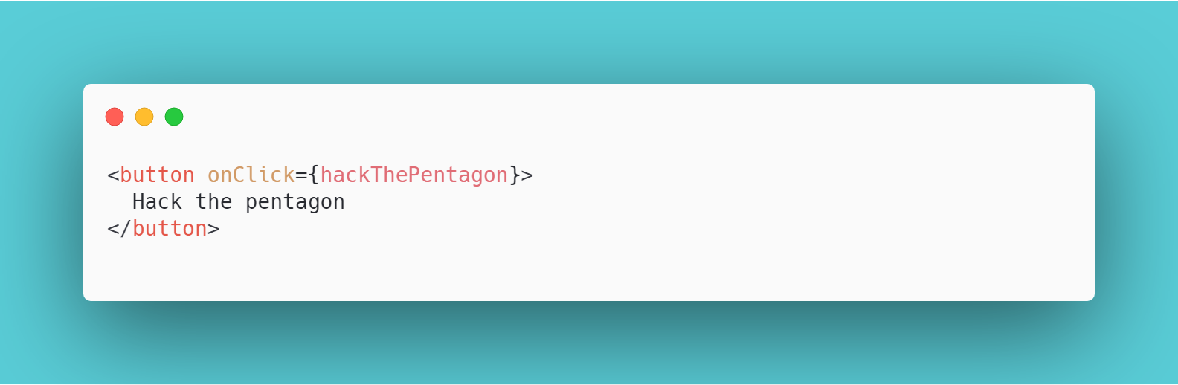
Handling event in React
XX

Slide 19
Synthetic events
Cross-browser wrapper around the browser’s native event
It has the same interface as the browser’s native event, including stopPropagation() and preventDefault()
Work identically across all browsers
XX

Slide 20
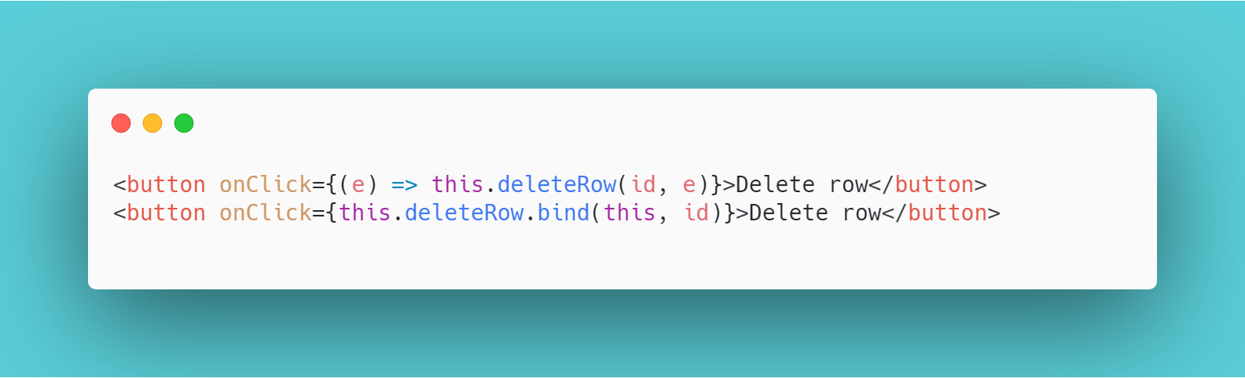
Passing arguments to event handlers
XX

Slide 21
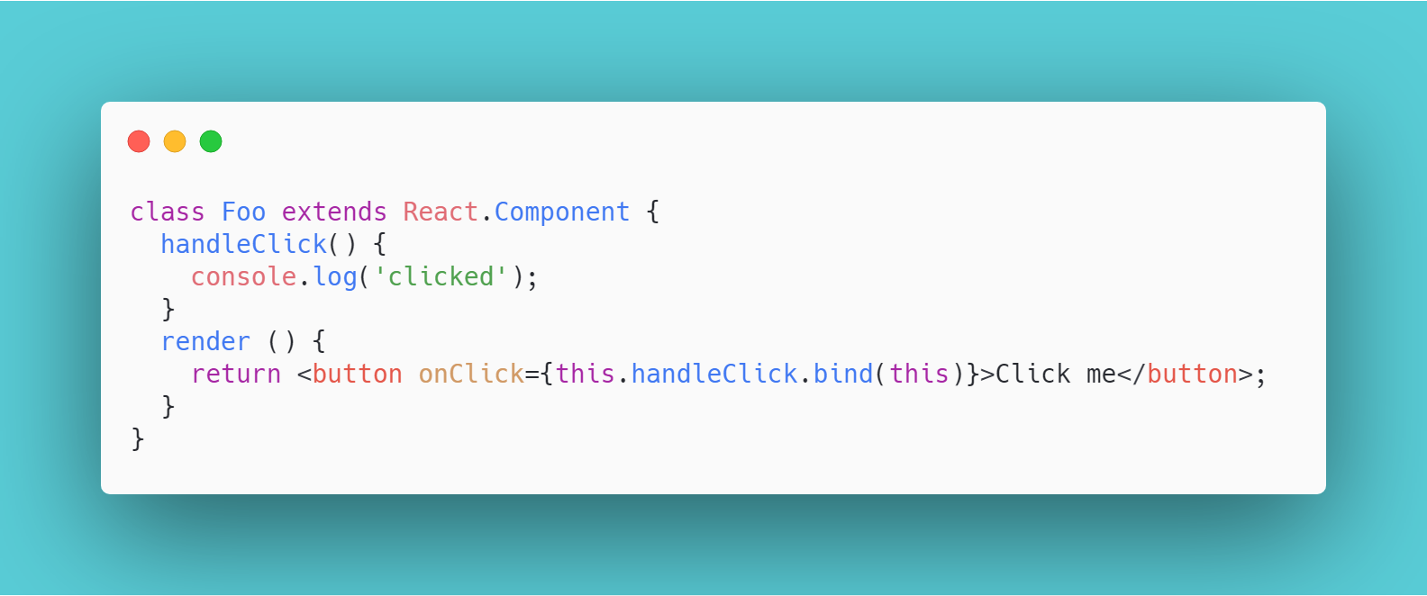
Binding functions in render
XX

Slide 22
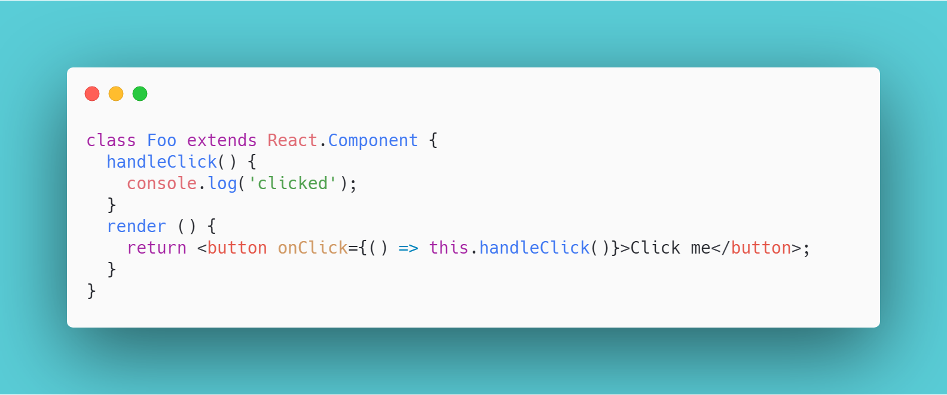
Binding functions in render
XX

Slide 23
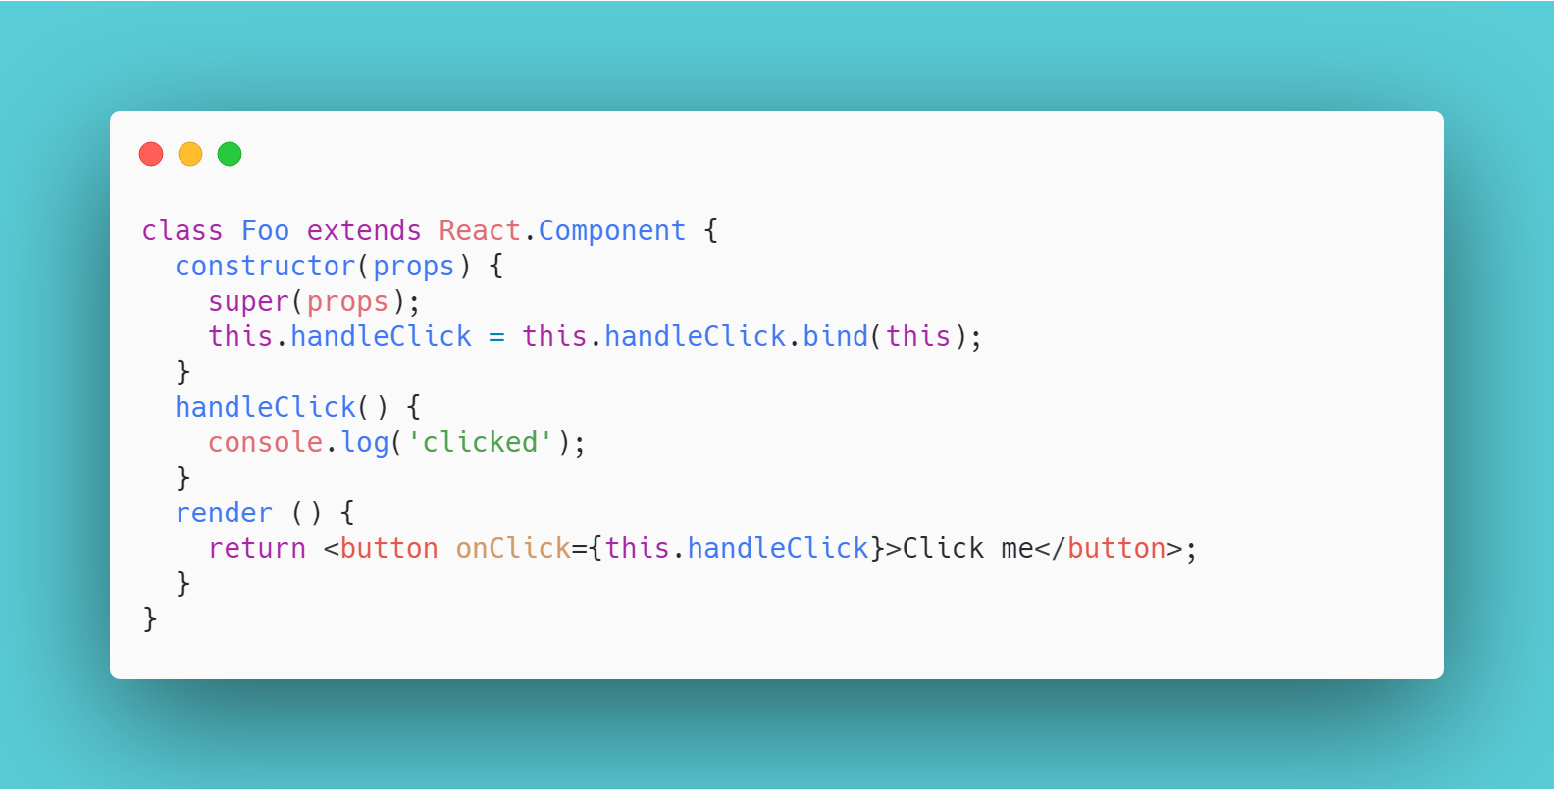
Binding functions in constructor
XX

Slide 24
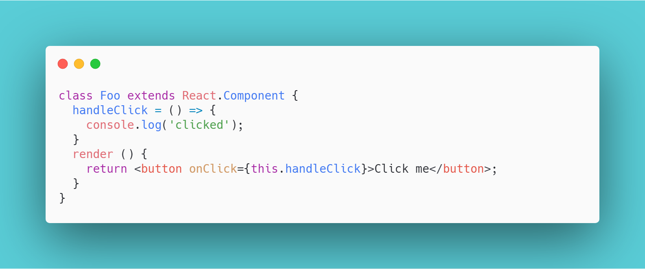
Class properties proposal(experimental)
XX

Slide 25
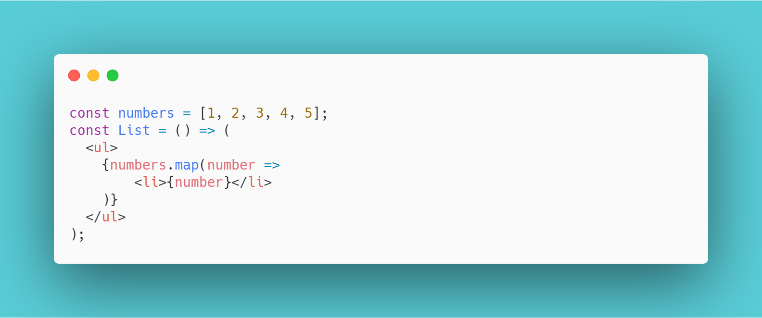
Work with arrays
XX

Slide 26
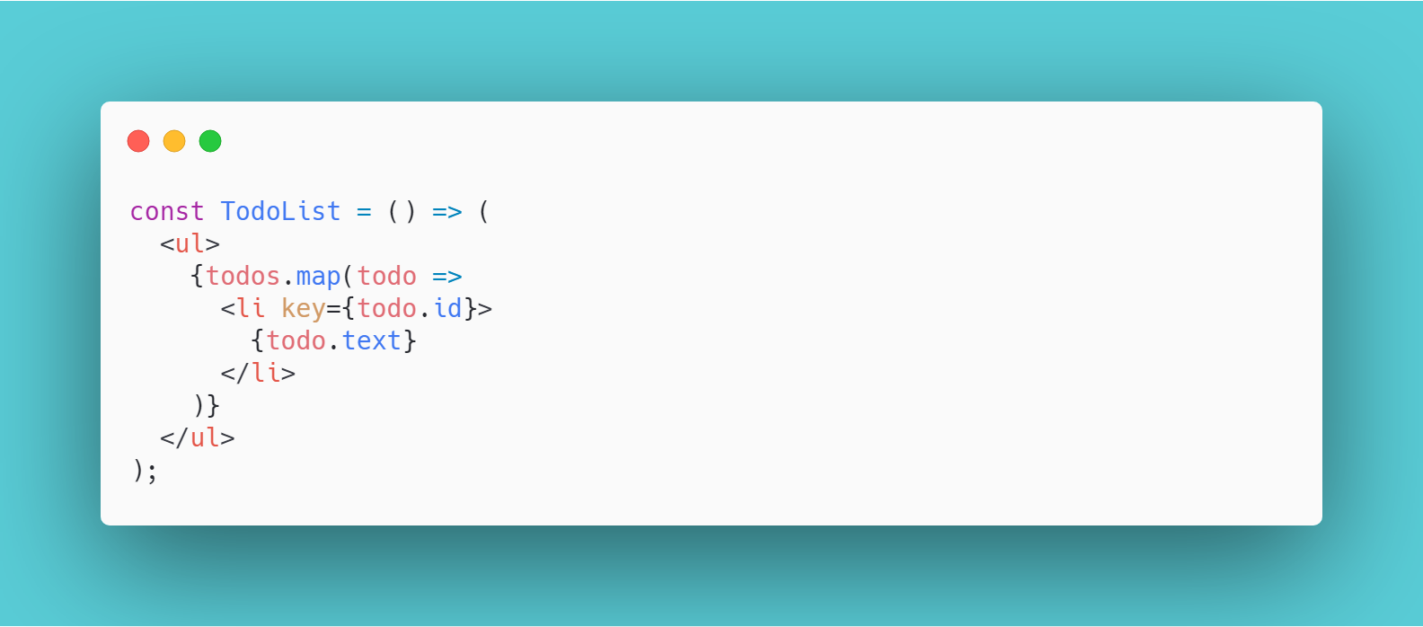
Work with arrays: keys
XX

Slide 27
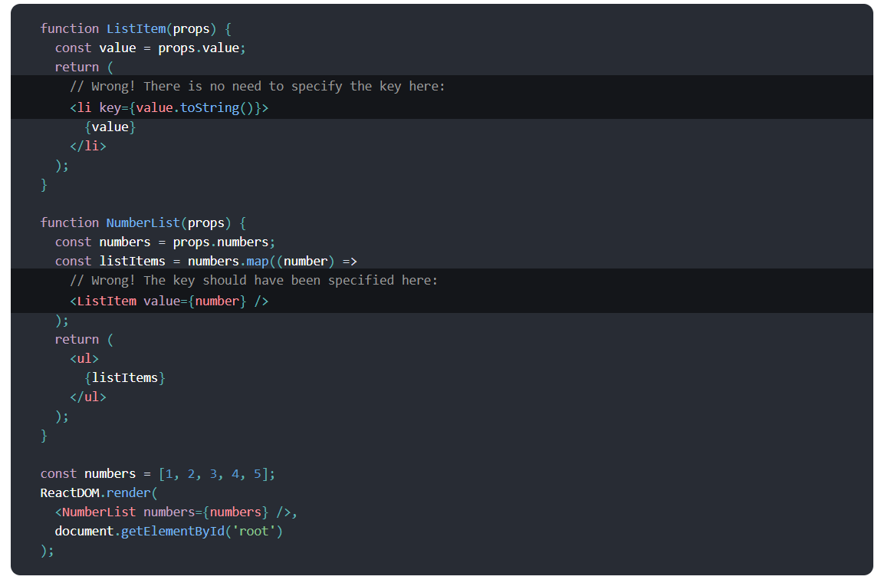
XX

Slide 28
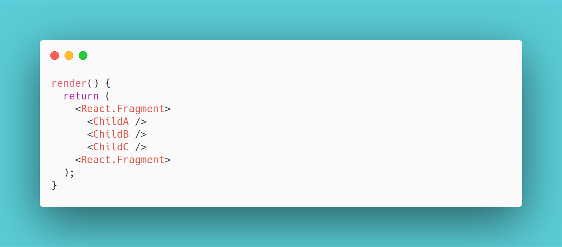
Returning multiple elements
XX

Slide 29
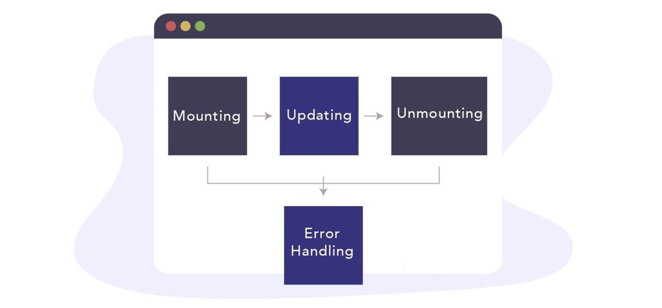
Component lifecycle
XX
Notes:
Container components will deal with the behavioral part. A container component tells the presentational component what should be rendered using props. It shouldn't contain limited DOM markups and styles. If you're using Redux, a container component contains the code that dispatches an action to a store. Alternatively, this is the place where you should place your API calls and store the result into the component's state. Coupled with Redux

Slide 30
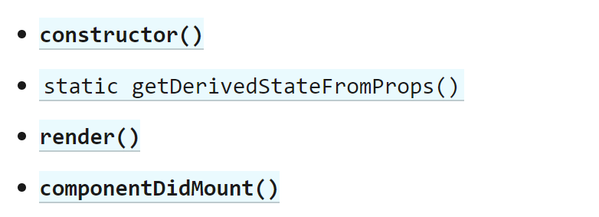
Component lifecycle: Mounting
XX
Notes:
Container components will deal with the behavioral part. A container component tells the presentational component what should be rendered using props. It shouldn't contain limited DOM markups and styles. If you're using Redux, a container component contains the code that dispatches an action to a store. Alternatively, this is the place where you should place your API calls and store the result into the component's state. Coupled with Redux

Slide 31
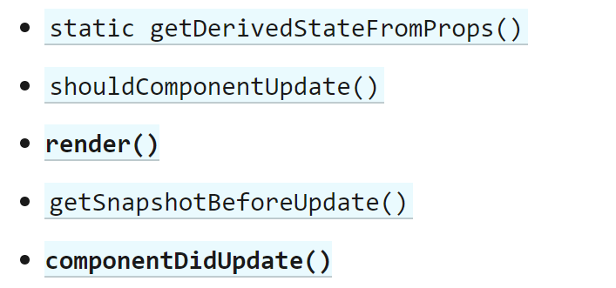
Component lifecycle: Updating
XX
Notes:
Container components will deal with the behavioral part. A container component tells the presentational component what should be rendered using props. It shouldn't contain limited DOM markups and styles. If you're using Redux, a container component contains the code that dispatches an action to a store. Alternatively, this is the place where you should place your API calls and store the result into the component's state. Coupled with Redux

Slide 32
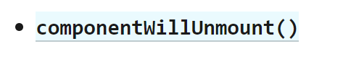
Component lifecycle: Unmounting
XX
Notes:
Container components will deal with the behavioral part. A container component tells the presentational component what should be rendered using props. It shouldn't contain limited DOM markups and styles. If you're using Redux, a container component contains the code that dispatches an action to a store. Alternatively, this is the place where you should place your API calls and store the result into the component's state. Coupled with Redux

Slide 33
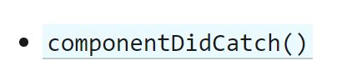
Component lifecycle: Error handling
XX
Notes:
Container components will deal with the behavioral part. A container component tells the presentational component what should be rendered using props. It shouldn't contain limited DOM markups and styles. If you're using Redux, a container component contains the code that dispatches an action to a store. Alternatively, this is the place where you should place your API calls and store the result into the component's state. Coupled with Redux

Slide 34
Lifecycle hooks diagram
http://projects.wojtekmaj.pl/react-lifecycle-methods-diagram/
XX
Notes:
Container components will deal with the behavioral part. A container component tells the presentational component what should be rendered using props. It shouldn't contain limited DOM markups and styles. If you're using Redux, a container component contains the code that dispatches an action to a store. Alternatively, this is the place where you should place your API calls and store the result into the component's state. Coupled with Redux

Slide 35
React.Component vs React.PureComponent
PureComponent is exactly the same as Component except that it handles the shouldComponentUpdate method for you
XX

Slide 36
Refs
Refs provide a way to access DOM nodes or React elements created in the render method.
There are a few good use cases for refs:
Managing focus, text selection, or media playback.
Triggering imperative animations.
Integrating with third-party DOM libraries.
XX

Slide 37
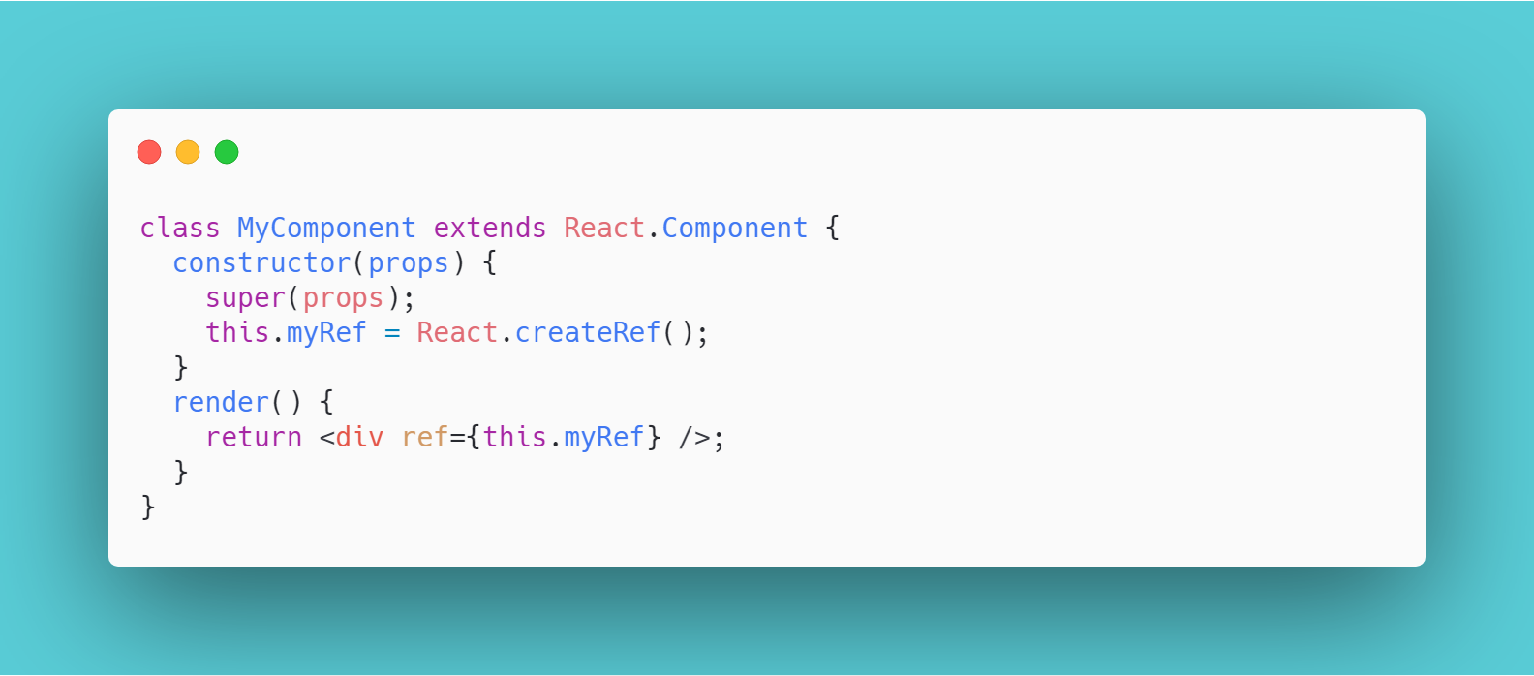
Creating refs
XX

Slide 38
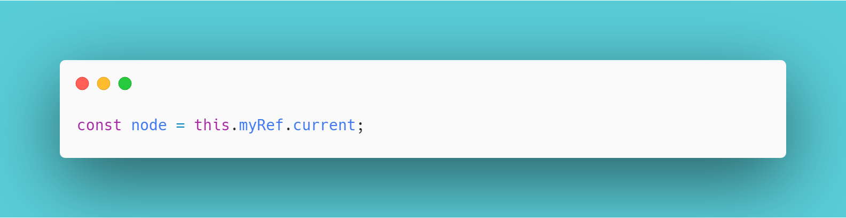
Accessing Refs
When a ref is passed to an element in render, a reference to the node becomes accessible at the current attribute of the ref.
XX

Slide 39

REACT / ROUTER

Slide 40

Web apps routing approaches
Sending request to a server for a new page on each route change
Single page application(SPA)
XX

Slide 41
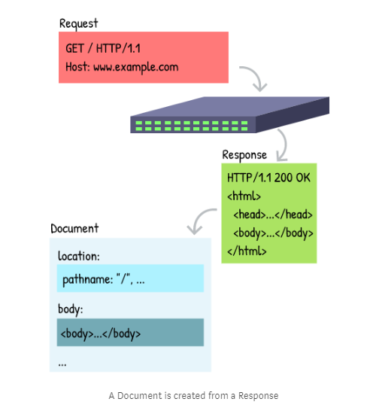
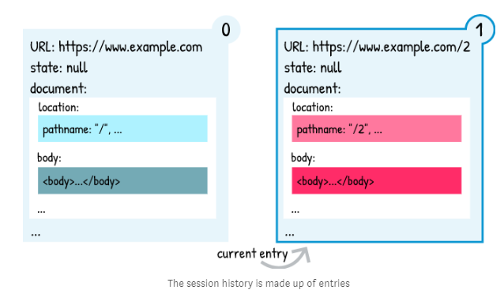
New document on each request
XX

Slide 42
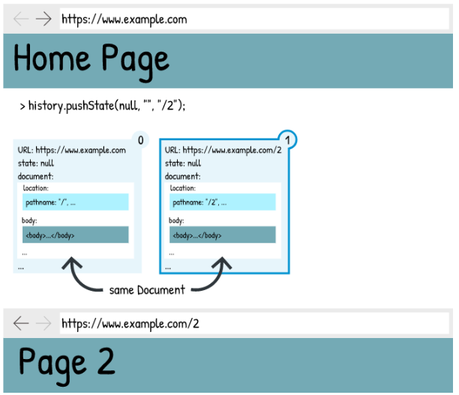
Single page application
A single-page application (SPA) is a website that re-renders its content in response to navigation actions (e.g. clicking a link) without making a request to the server to fetch new HTML.
XX

Slide 43
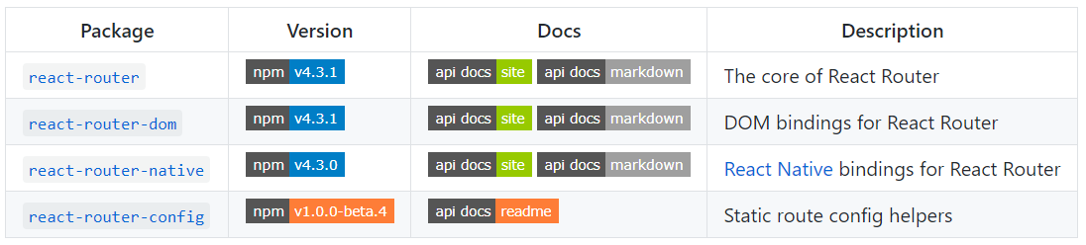
React Router v4
React Router v4 is a pure React rewrite of the popular React package. Previous versions of React Router used configuration disguised as pseudo-components and could be difficult to understand. With v4, everything is “just components”.
XX

Slide 44
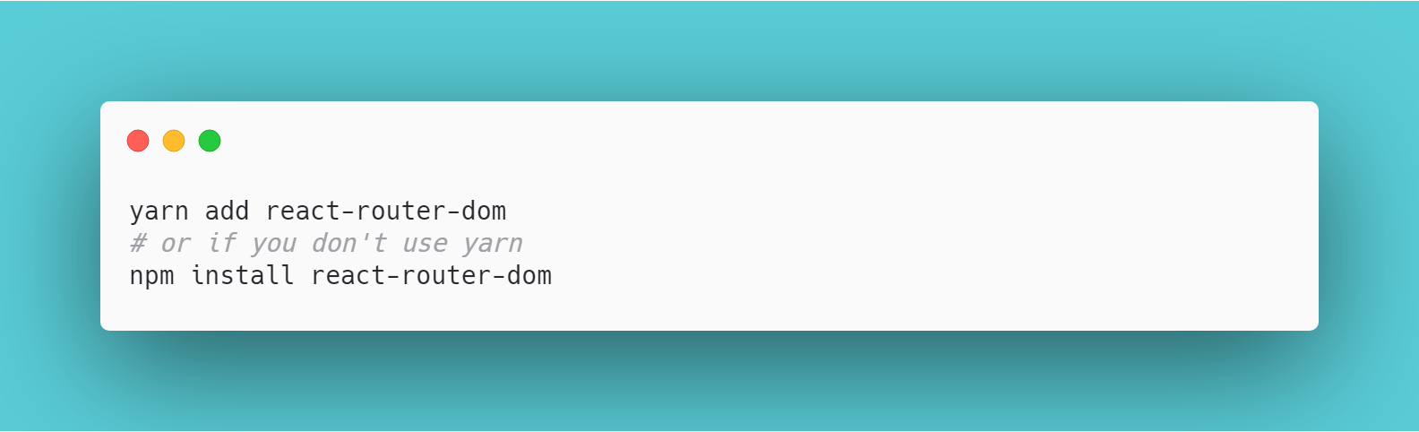
Installation
Use npm or yarn to add the package to your project
XX

Slide 45
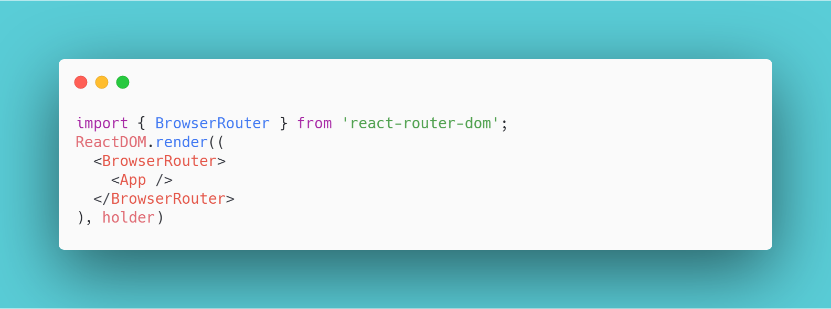
Routers
At the core of every React Router application should be a router component. For web projects, react-router-dom provides <BrowserRouter> and <HashRouter> routers
XX

Slide 46
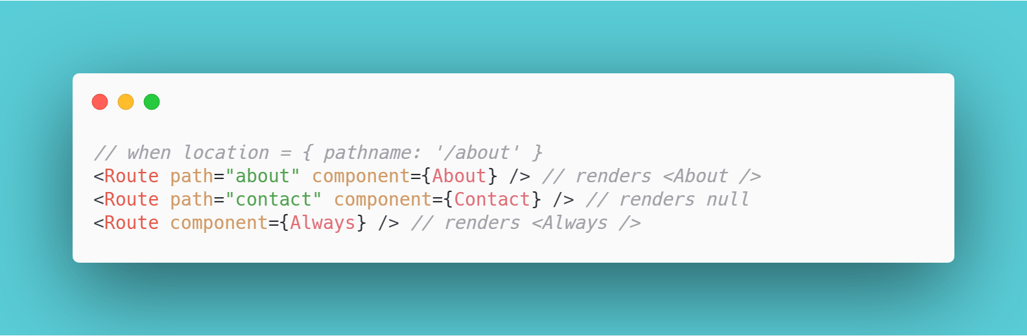
Defining routes
Route matching is done by comparing a <Route>'s path prop to the current location’s pathname. When a <Route> matches it will render its content and when it does not match, it will render null. A <Route> with no path will always match.
XX

Slide 47
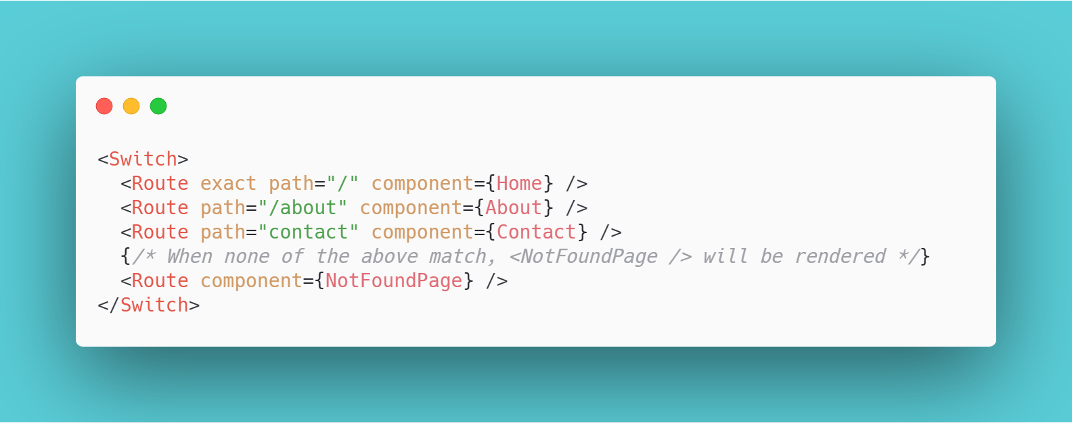
Grouping routes
The <Switch> is not required for grouping <Route>s, but it can be quite useful. A <Switch> will iterate over all of its children <Route> elements and only render the first one that matches the current location.
XX

Slide 48
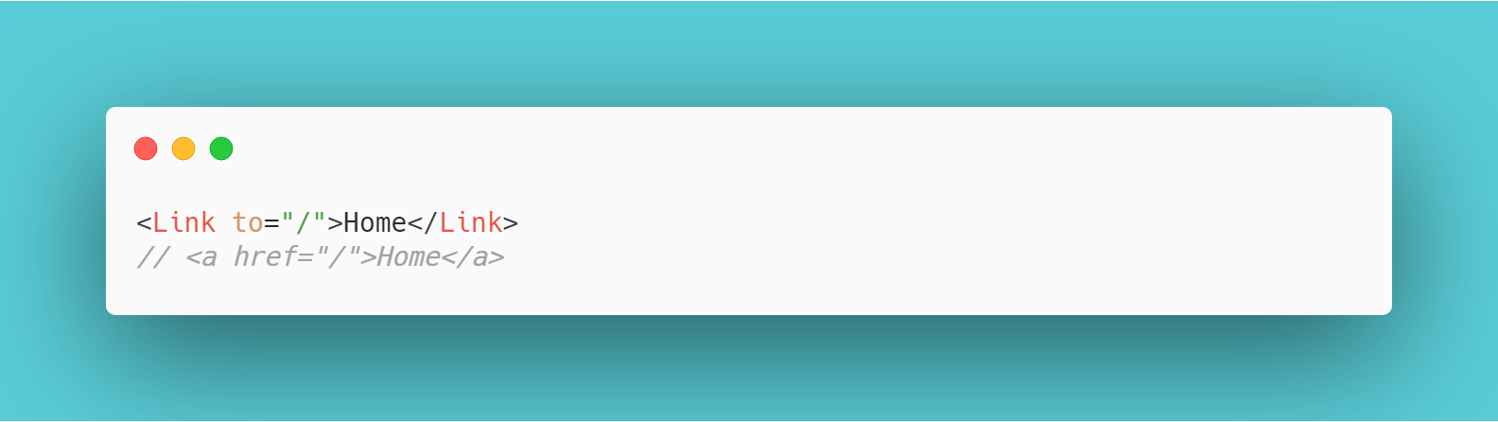
Navigation
React Router provides a <Link> component to create links in your application. Wherever you render a <Link>, an anchor (<a>) will be rendered in your application’s HTML.
XX

Slide 49
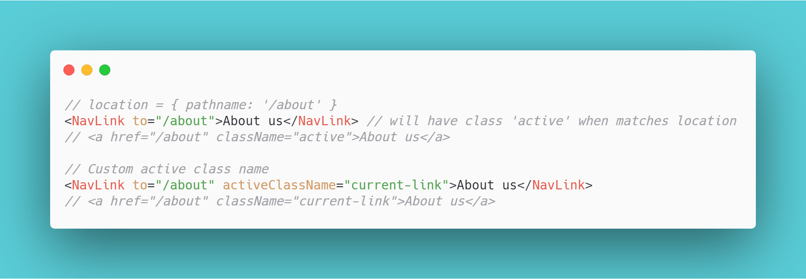
Styling active link
The <NavLink> is a special type of <Link> that can style itself as “active” when its to prop matches the current location.
XX

Slide 50
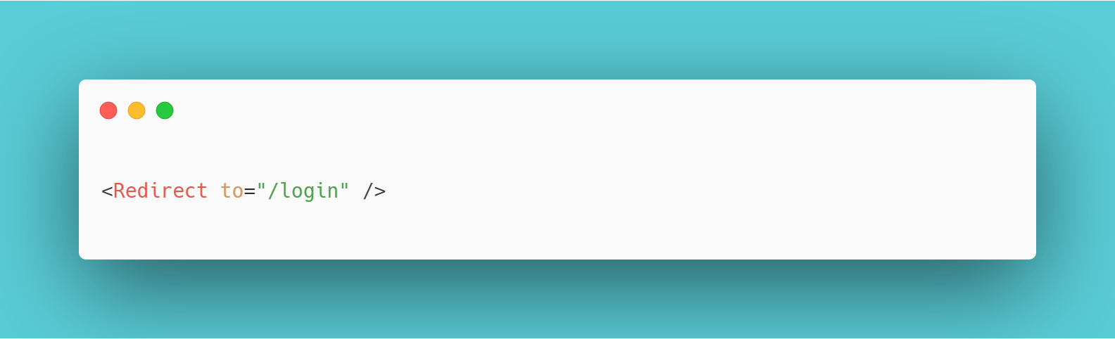
Redirect to the other page
Any time that you want to force navigation, you can render a <Redirect>. When a <Redirect> renders, it will navigate using its to prop.
XX

Slide 51
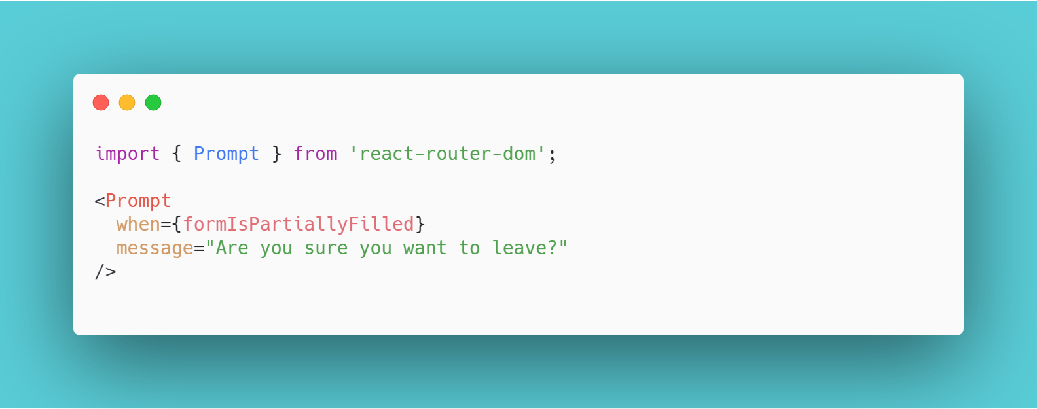
Prompt action before leaving the page
When your application enters a state that should prevent the user from navigating away (like a form is half-filled out), render a <Prompt>.
XX

Slide 52
Thank you!
Notes:
https://codesandbox.io/embed/github/pfrancug/LoginPanel/tree/master/
https://www.metaweather.com/924938/

